Slide 1
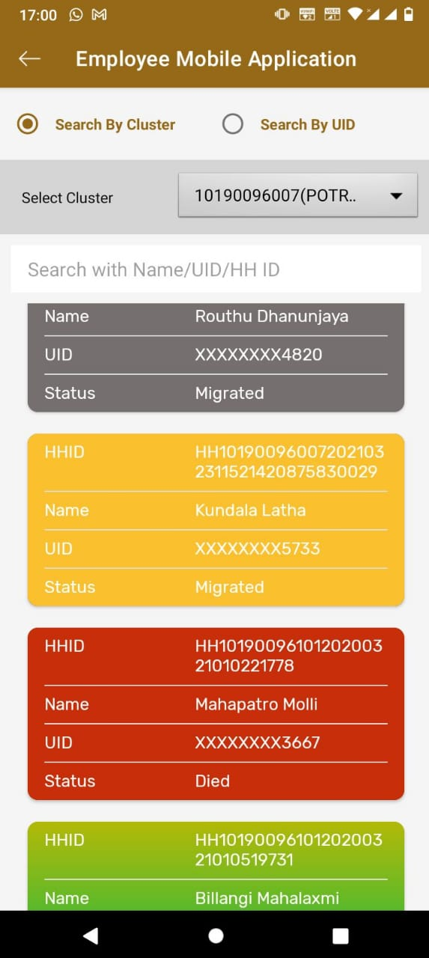
Geo-coordinates colour codes
HH Geo location image Captured households Showing Green colour.
Migrated HH Outside AP showing Yellow Colour.
Migrated households within AP, in Migrated Secretariats Showing Grey colour and re-survey the Grey colour House Holds.
Death cases showing red colour.
.
.

